Slide 1
1*1*4096
4*4*256
8*8*256
Conv
batchnormalization
relu
upsampling
conv2dTranspose
（4*4）
relu

Slide 2









Generator
Conv2D (256@4$×$4)
Conv2DTranspose (256@4$×$4)
BatchNormalization (0.7)
ReLU
ReLU
GBlock(256@4$×$4)
UpSampling2D
GBlock(128@4$×$4)
GBlock(64@3$×3$)
GBlock(32@3$×3$)
GBlock(16@3$×3$)
Conv2D (8@3$×3$)
ReLU
UpSampling2D
Conv2D (3@3$×3$)
Sigmoid

Slide 3
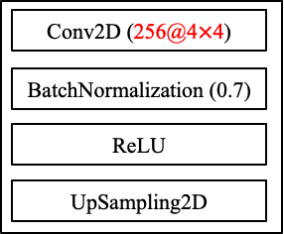









Conv2DTranspose (4$×$4)
Conv2D (4$×$4)
Generator
ReLU
BatchNormalization (0.7)
G-Block(4$×$4)
ReLU
G-Block(4$×$4)
UpSampling2D
G-Block(3$×3$)
G-Block(3$×3$)
G-Block(3$×3$)
Conv2D 3$×3$)
ReLU
UpSampling2D
Conv2D (3$×3$)
Sigmoid

Slide 4







Conv2D (3$×3$)
GaussianNoise (0.2)
BatchNormalization (0.7)
Conv2D (3$×3$)
LeakyReLU (0.2)
LeakyReLU (0.2)
Dropout (0.25)
AveragePooling2D
Discriminator
Dropout (0.25)
AveragePooling2D
D-Block(3$×3$)
D-Block(3$×3$)
D-Block(3$×3$)
D-Block(3$×3$)
D-Block(3$×3$)
Flatten
Dense(128)
LeakyReLU (0.2)
Dense(1)

Slide 5








Discriminator
Conv2D (16@3$×3$)
GaussianNoise (0.2)
BatchNormalization (0.7)
Conv2D (8@3$×3$)
LeakyReLU (0.2)
LeakyReLU (0.2)
Dropout (0.25)
Dropout (0.25)
AveragePooling2D
AveragePooling2D
DBlock(16@3$×3$)
DBlock(32@3$×3$)
DBlock(64@3$×3$)
DBlock(128@3$×3$)
UpSampling2D
DBlock(256@3$×3$)
Conv2D (3@3$×3$)
Flatten
Sigmoid
Dense(128)
LeakyReLU (0.2)
Dense(1)

Slide 6
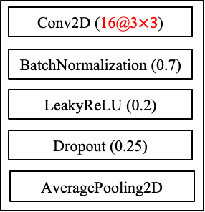
Discriminator
GaussianNoise (0.2)
Conv2D (8@3$×3$)
LeakyReLU (0.2)
Dropout (0.25)
AveragePooling2D
DBlock(16@3$×3$)
DBlock(32@3$×3$)
DBlock(64@3$×3$)
DBlock(128@3$×3$)
DBlock(256@3$×3$)
Flatten
Dense(128)
LeakyReLU (0.2)
Dense(1)

Slide 7
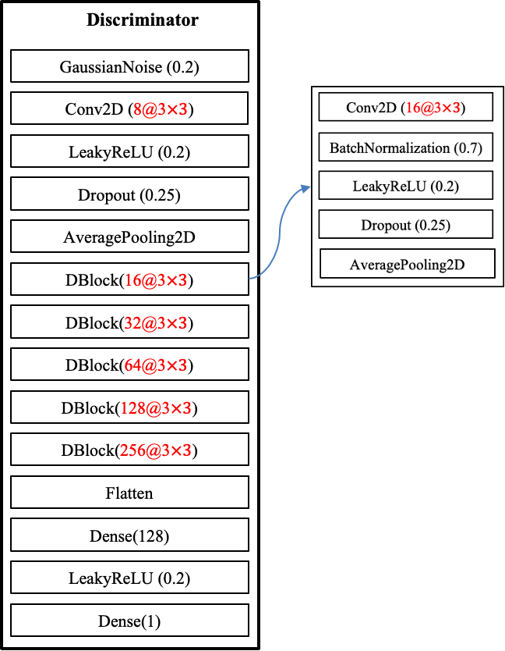
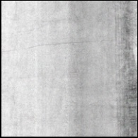
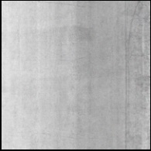
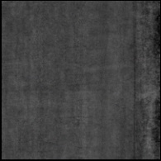
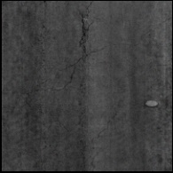
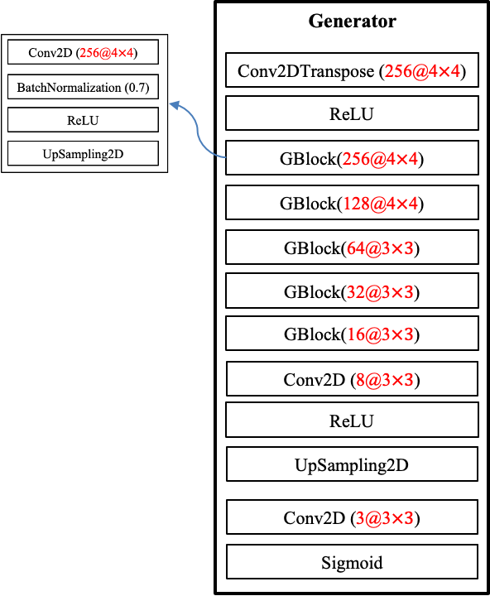
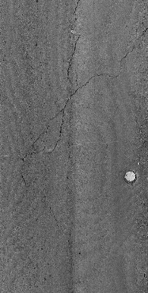
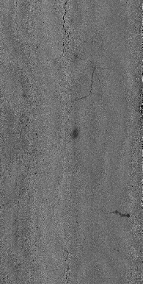
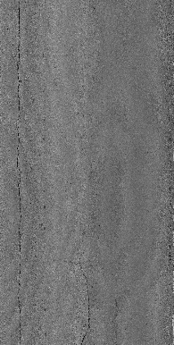
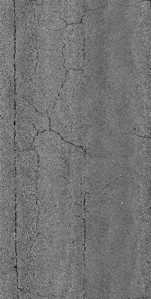
Random input vector (4096)
Update
model
Fake images
Real/fake
Real images
Update model

Slide 8
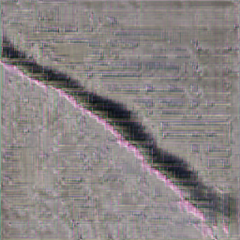
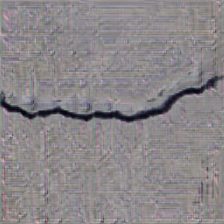
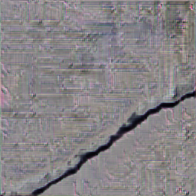
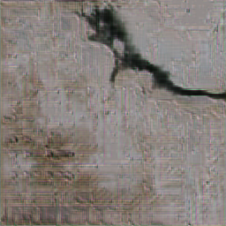
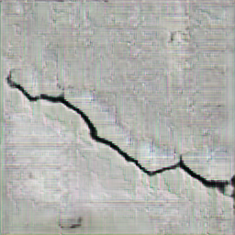
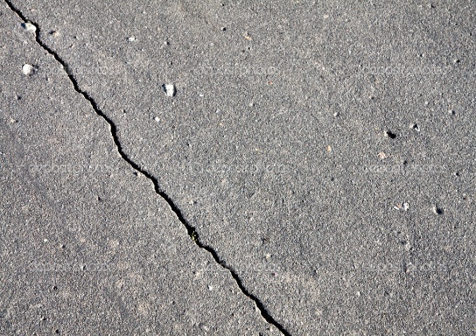
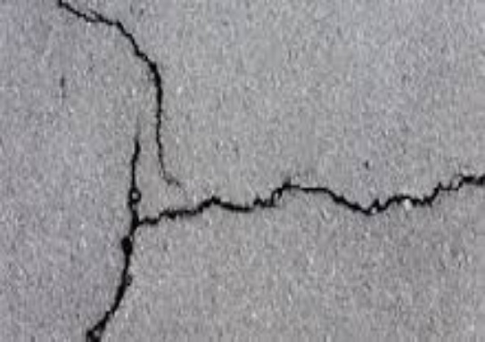
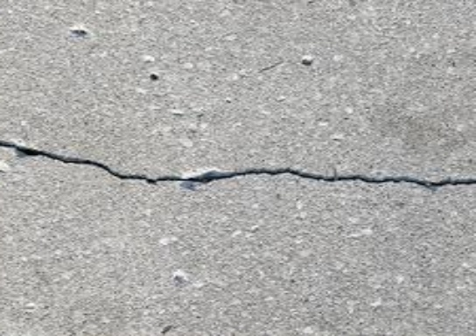
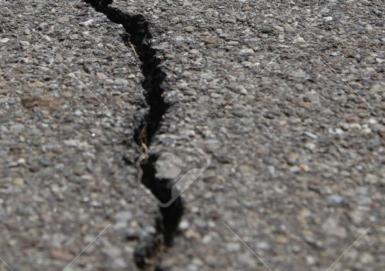
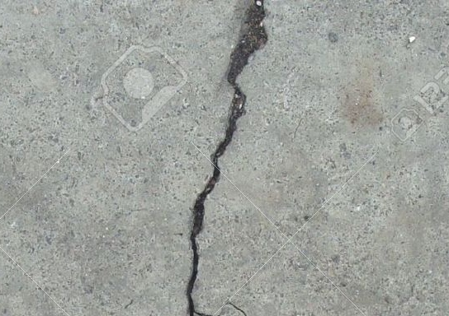
















Random input vector (4096)
Conv2DTranspose (4$×$4)
GaussianNoise (0.2)
ReLU
Fake images
Conv2D (3$×3$)
G-Block
G-Block(4$×$4)
LeakyReLU (0.2)
Conv2D (4$×$4)
G-Block(4$×$4)
Dropout (0.25)
BatchNormalization (0.7)
G-Block(3$×3$)
AveragePooling2D
ReLU
G-Block(3$×3$)
D-Block(3$×3$)
UpSampling2D
G-Block(3$×3$)
D-Block(3$×3$)
Conv2D(3$×3$)
D-Block(3$×3$)
D-Block
ReLU
D-Block(3$×3$)
Conv2D (3$×3$)
UpSampling2D
D-Block(3$×3$)
BatchNormalization (0.7)
Conv2D (3$×3$)
Flatten
LeakyReLU (0.2)
Sigmoid
Dense(128)
Dropout (0.25)
Real images
LeakyReLU (0.2)
AveragePooling2D
Dense(1)
Real/fake
Update model
Update model

Slide 9
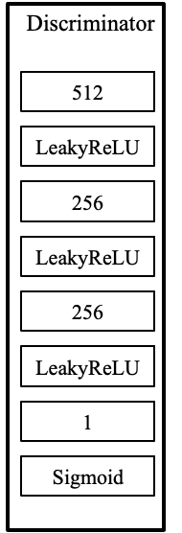
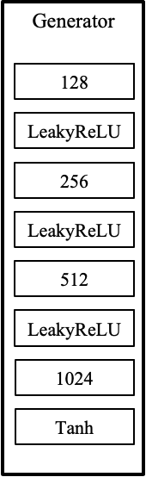
Random input vector
Fake images
Update
model
Real images
Real/fake
Update model

Slide 10
Discriminator
512
LeakyReLU
256
LeakyReLU
256
LeakyReLU
1
Sigmoid

Slide 11
class AttU_Net(nn.Module):
"""
Attention Unet implementation
Paper: https://arxiv.org/abs/1804.03999
"""
def __init__(self, img_ch=3, output_ch=1):
super(AttU_Net, self).__init__()
n1 = 64
filters = [n1, n1 * 2, n1 * 4, n1 * 8, n1 * 16]
self.Maxpool1 = nn.MaxPool2d(kernel_size=2, stride=2)
self.Maxpool2 = nn.MaxPool2d(kernel_size=2, stride=2)
self.Maxpool3 = nn.MaxPool2d(kernel_size=2, stride=2)
self.Maxpool4 = nn.MaxPool2d(kernel_size=2, stride=2)
self.Conv1 = conv_block(img_ch, filters[0])
self.Conv2 = conv_block(filters[0], filters[1])
self.Conv3 = conv_block(filters[1], filters[2])
self.Conv4 = conv_block(filters[2], filters[3])
self.Conv5 = conv_block(filters[3], filters[4])
self.Up5 = up_conv(filters[4], filters[3])
self.Att5 = Attention_block(F_g=filters[3], F_l=filters[3], F_int=filters[2])
self.Up_conv5 = conv_block(filters[4], filters[3])
self.Up4 = up_conv(filters[3], filters[2])
self.Att4 = Attention_block(F_g=filters[2], F_l=filters[2], F_int=filters[1])
self.Up_conv4 = conv_block(filters[3], filters[2])
self.Up3 = up_conv(filters[2], filters[1])
self.Att3 = Attention_block(F_g=filters[1], F_l=filters[1], F_int=filters[0])
self.Up_conv3 = conv_block(filters[2], filters[1])
self.Up2 = up_conv(filters[1], filters[0])
self.Att2 = Attention_block(F_g=filters[0], F_l=filters[0], F_int=32)
self.Up_conv2 = conv_block(filters[1], filters[0])
self.Conv = nn.Conv2d(filters[0], output_ch, kernel_size=1, stride=1, padding=0)
#self.active = torch.nn.Sigmoid()
def forward(self, x):
e1 = self.Conv1(x)
e2 = self.Maxpool1(e1)
e2 = self.Conv2(e2)
e3 = self.Maxpool2(e2)
e3 = self.Conv3(e3)
e4 = self.Maxpool3(e3)
e4 = self.Conv4(e4)
e5 = self.Maxpool4(e4)
e5 = self.Conv5(e5)
#print(x5.shape)
d5 = self.Up5(e5)
#print(d5.shape)
x4 = self.Att5(g=d5, x=e4)
d5 = torch.cat((x4, d5), dim=1)
d5 = self.Up_conv5(d5)
d4 = self.Up4(d5)
x3 = self.Att4(g=d4, x=e3)
d4 = torch.cat((x3, d4), dim=1)
d4 = self.Up_conv4(d4)
d3 = self.Up3(d4)
x2 = self.Att3(g=d3, x=e2)
d3 = torch.cat((x2, d3), dim=1)
d3 = self.Up_conv3(d3)
d2 = self.Up2(d3)
x1 = self.Att2(g=d2, x=e1)
d2 = torch.cat((x1, d2), dim=1)
d2 = self.Up_conv2(d2)
out = self.Conv(d2)
# out = self.active(out)
class Attention_block(nn.Module):
"""
Attention Block
"""
def __init__(self, F_g, F_l, F_int):
super(Attention_block, self).__init__()
self.W_g = nn.Sequential(
nn.Conv2d(F_l, F_int, kernel_size=1, stride=1, padding=0, bias=True),
nn.BatchNorm2d(F_int)
)
self.W_x = nn.Sequential(
nn.Conv2d(F_g, F_int, kernel_size=1, stride=1, padding=0, bias=True),
nn.BatchNorm2d(F_int)
)
self.psi = nn.Sequential(
nn.Conv2d(F_int, 1, kernel_size=1, stride=1, padding=0, bias=True),
nn.BatchNorm2d(1),
nn.Sigmoid()
)
self.relu = nn.ReLU(inplace=True)
def forward(self, g, x):
g1 = self.W_g(g)
x1 = self.W_x(x)
psi = self.relu(g1 + x1)
psi = self.psi(psi)
out = x * psi
return out

Slide 12
class Attention_block(nn.Module):
"""
Attention Block
"""
def __init__(self, F_g, F_l, F_int):
super(Attention_block, self).__init__()
self.W_g = nn.Sequential(
nn.Conv2d(F_l, F_int, kernel_size=1, stride=1, padding=0, bias=True),
nn.BatchNorm2d(F_int)
)
self.W_x = nn.Sequential(
nn.Conv2d(F_g, F_int, kernel_size=1, stride=1, padding=0, bias=True),
nn.BatchNorm2d(F_int)
)
self.psi = nn.Sequential(
nn.Conv2d(F_int, 1, kernel_size=1, stride=1, padding=0, bias=True),
nn.BatchNorm2d(1),
nn.Sigmoid()
)
self.relu = nn.ReLU(inplace=True)
def forward(self, g, x):
g1 = self.W_g(g)
x1 = self.W_x(x)
psi = self.relu(g1 + x1)
psi = self.psi(psi)
out = x * psi
return out
g
x
Conv2D (g, t, 1, 1)
Conv2D (x, t, 1, 1)
BatchNormalization
BatchNormalization
+
ReLU
Conv2D (t, 1, 1, 1)
BatchNormalization
Sigmoid
+

Slide 13



class Attention_block(nn.Module):
"""
Attention Block
"""
def __init__(self, F_g, F_l, F_int):
super(Attention_block, self).__init__()
self.W_g = nn.Sequential(
nn.Conv2d(F_l, F_int, kernel_size=1, stride=1, padding=0, bias=True),
nn.BatchNorm2d(F_int)
)
self.W_x = nn.Sequential(
nn.Conv2d(F_g, F_int, kernel_size=1, stride=1, padding=0, bias=True),
nn.BatchNorm2d(F_int)
)
self.psi = nn.Sequential(
nn.Conv2d(F_int, 1, kernel_size=1, stride=1, padding=0, bias=True),
nn.BatchNorm2d(1),
nn.Sigmoid()
)
self.relu = nn.ReLU(inplace=True)
def forward(self, g, x):
g1 = self.W_g(g)
x1 = self.W_x(x)
psi = self.relu(g1 + x1)
psi = self.psi(psi)
out = x * psi
return out
g
x
Conv2D ($1×1$)
Conv2D ($1×1$)
BatchNormalization
BatchNormalization
+
ReLU
Conv2D ($1×1$)
BatchNormalization
Sigmoid
+

Slide 14
























class AttU_Net(nn.Module):
"""
Attention Unet implementation
Paper: https://arxiv.org/abs/1804.03999
"""
def __init__(self, img_ch=3, output_ch=1):
super(AttU_Net, self).__init__()
n1 = 64
filters = [n1, n1 * 2, n1 * 4, n1 * 8, n1 * 16]
self.Maxpool1 = nn.MaxPool2d(kernel_size=2, stride=2)
self.Maxpool2 = nn.MaxPool2d(kernel_size=2, stride=2)
self.Maxpool3 = nn.MaxPool2d(kernel_size=2, stride=2)
self.Maxpool4 = nn.MaxPool2d(kernel_size=2, stride=2)
self.Conv1 = conv_block(img_ch, filters[0])
self.Conv2 = conv_block(filters[0], filters[1])
self.Conv3 = conv_block(filters[1], filters[2])
self.Conv4 = conv_block(filters[2], filters[3])
self.Conv5 = conv_block(filters[3], filters[4])
self.Up5 = up_conv(filters[4], filters[3])
self.Att5 = Attention_block(F_g=filters[3], F_l=filters[3], F_int=filters[2])
self.Up_conv5 = conv_block(filters[4], filters[3])
self.Up4 = up_conv(filters[3], filters[2])
self.Att4 = Attention_block(F_g=filters[2], F_l=filters[2], F_int=filters[1])
self.Up_conv4 = conv_block(filters[3], filters[2])
self.Up3 = up_conv(filters[2], filters[1])
self.Att3 = Attention_block(F_g=filters[1], F_l=filters[1], F_int=filters[0])
self.Up_conv3 = conv_block(filters[2], filters[1])
self.Up2 = up_conv(filters[1], filters[0])
self.Att2 = Attention_block(F_g=filters[0], F_l=filters[0], F_int=32)
self.Up_conv2 = conv_block(filters[1], filters[0])
self.Conv = nn.Conv2d(filters[0], output_ch, kernel_size=1, stride=1, padding=0)
#self.active = torch.nn.Sigmoid()
def forward(self, x):
e1 = self.Conv1(x)
e2 = self.Maxpool1(e1)
e2 = self.Conv2(e2)
e3 = self.Maxpool2(e2)
e3 = self.Conv3(e3)
e4 = self.Maxpool3(e3)
e4 = self.Conv4(e4)
e5 = self.Maxpool4(e4)
e5 = self.Conv5(e5)
#print(x5.shape)
d5 = self.Up5(e5)
#print(d5.shape)
x4 = self.Att5(g=d5, x=e4)
d5 = torch.cat((x4, d5), dim=1)
d5 = self.Up_conv5(d5)
d4 = self.Up4(d5)
x3 = self.Att4(g=d4, x=e3)
d4 = torch.cat((x3, d4), dim=1)
d4 = self.Up_conv4(d4)
d3 = self.Up3(d4)
x2 = self.Att3(g=d3, x=e2)
d3 = torch.cat((x2, d3), dim=1)
d3 = self.Up_conv3(d3)
d2 = self.Up2(d3)
x1 = self.Att2(g=d2, x=e1)
d2 = torch.cat((x1, d2), dim=1)
d2 = self.Up_conv2(d2)
out = self.Conv(d2)
# out = self.active(out)
class conv_block(nn.Module):
"""
Convolution Block
"""
def __init__(self, in_ch, out_ch):
super(conv_block, self).__init__()
self.conv = nn.Sequential(
nn.Conv2d(in_ch, out_ch, kernel_size=3, stride=1, padding=1, bias=True),
nn.BatchNorm2d(out_ch),
nn.ReLU(inplace=True),
nn.Conv2d(out_ch, out_ch, kernel_size=3, stride=1, padding=1, bias=True),
nn.BatchNorm2d(out_ch),
nn.ReLU(inplace=True))
def forward(self, x):
x = self.conv(x)
return x
$$256×32×32×3$$
$$512×32×32×3$$
$$64×128×128×3$$
$$128×128×128×3$$
$$512×16×16×3$$
$$1×256×256×3$$
$$64×256×256×3$$
$$128×64×64×3$$
$$256×64×64×3$$
$$128×128×128×3$$
$$256×64×64×3$$
$$128×128×128×3$$
$$128×128×128×3$$
$$1024×16×16×3$$
$$512×32×32×3$$
$$512×32×32×3$$
$$256×64×64×3$$
$$256×64×64×3$$
$$512×32×32×3$$
class up_conv(nn.Module):
"""
Up Convolution Block
"""
def __init__(self, in_ch, out_ch):
super(up_conv, self).__init__()
self.up = nn.Sequential(
nn.Upsample(scale_factor=2),
nn.Conv2d(in_ch, out_ch, kernel_size=3, stride=1, padding=1, bias=True),
nn.BatchNorm2d(out_ch),
nn.ReLU(inplace=True)
)
def forward(self, x):
x = self.up(x)
return x
$$1×256×256×3$$
$$64×256×256×3$$
$$64×256×256×3$$
$$64×256×256×3$$
Conv ($3×3$)
ReLU
MaxPool(2)
Upsample(2)

Slide 15

























$$64×256×256×3$$
$$N_{c}×256×256×3$$
$$64×256×256×3$$
$$64×256×256×3$$
$$1×256×256×3$$
$$64×256×256×3$$
$$64×128×128×3$$
$$128×128×128×3$$
$$128×128×128×3$$
$$128×128×128×3$$
$$128×128×128×3$$
$$128×64×64×3$$
$$256×64×64×3$$
$$256×64×64×3$$
$$256×64×64×3$$
$$256×64×64×3$$
$$256×32×32×3$$
$$512×32×32×3$$
$$512×32×32×3$$
$$512×32×32×3$$
$$512×32×32×3$$
$$1024×16×16×3$$
$$512×16×16×3$$
Conv ($3×3$) + ReLU + Conv (3$×3$) + ReLU
MaxPool (2)
Upsample (2) + Conv($3×3$) + ReLU
Attention module

Slide 16
























$$64×256×256×3$$
$$1×256×256×3$$
$$64×256×256×3$$
$$N_{c}×256×256×3$$
$$64×256×256×3$$
$$64×256×256×3$$
$$64×128×128×3$$
$$128×128×128×3$$
$$128×128×128×3$$
$$128×128×128×3$$
$$128×128×128×3$$
$$256×64×64×3$$
$$256×64×64×3$$
$$128×64×64×3$$
$$256×64×64×3$$
$$256×64×64×3$$
$$512×32×32×3$$
$$512×32×32×3$$
$$256×32×32×3$$
$$512×32×32×3$$
$$512×32×32×3$$
Conv ($3×3$) + ReLU + Conv (3$×3$) + ReLU
$$1024×16×16×3$$
$$512×16×16×3$$
MaxPool (2)
Upsample (2) + Conv($3×3$) + ReLU
Conv ($1×1$)
Attention module

Slide 17


























$$1×256×256×3$$
$$64×256×256×3$$
$$64×128×128×3$$
$$128×128×128×3$$
$$128×64×64×3$$
$$512×32×32×3$$
$$512×32×32×3$$
$$512×32×32×3$$
$$256×64×64×3$$
$$128×128×128×3$$
$$64×256×256×3$$
$$64×256×256×3$$
$$64×256×256×3$$
$$256×64×64×3$$
$$N_{c}×256×256×3$$
$$256×32×32×3$$
$$512×32×32×3$$
$$512×16×16×3$$
$$1024×16×16×3$$
$$256×64×64×3$$
$$256×64×64×3$$
$$128×128×128×3$$
$$128×128×128×3$$
Conv ($3×3$) + ReLU + Conv (3$×3$) + ReLU
MaxPool (2)
Upsample (2) + Conv($3×3$) + ReLU
Conv ($1×1$)
Attention module

Slide 18



$$1×256×256×3$$
$$64×256×256×3$$
$$64×128×128×3$$
$$128×128×128×3$$
$$128×64×64×3$$
$$512×32×32×3$$
$$512×32×32×3$$
$$512×32×32×3$$
$$256×64×64×3$$
$$128×128×128×3$$
$$64×256×256×3$$
$$64×256×256×3$$
$$64×256×256×3$$
$$256×64×64×3$$
$$N_{c}×256×256×3$$
$$256×32×32×3$$
$$512×32×32×3$$
$$512×16×16×3$$
$$1024×16×16×3$$
$$256×64×64×3$$
$$256×64×64×3$$
$$128×128×128×3$$
$$128×128×128×3$$
Conv ($3×3$) + ReLU + Conv (3$×3$) + LogSigmoid
MinPool (2)
Upsample (2) + Conv($3×3$) + LogSigmoid
Conv ($1×1$)
Attention module

